Slide 1

Government Expenditure

Slide 2
Data on Government Expenditure

Slide 3
Data on Government Expenditure
Government Expenditure： the amount spent at all levels of government for purchases of goods and services, transfer payments (amounts given to households and businesses), and interest payments of government bonds.

Slide 4
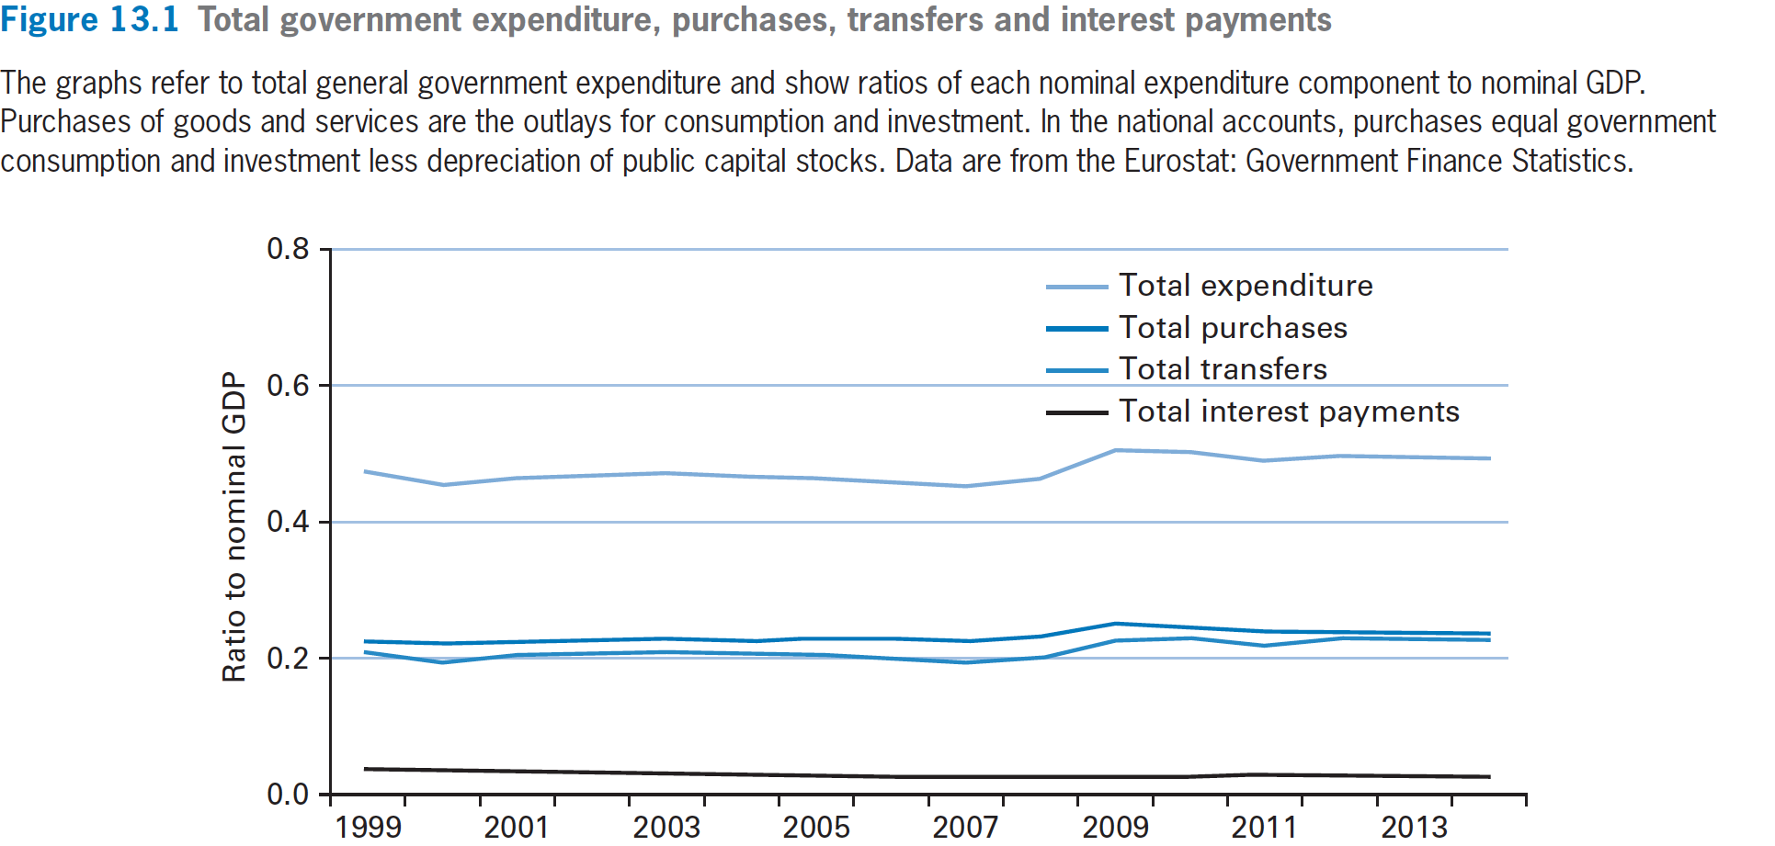
Data on Government Expenditure：Eurozone
中国财政支出占GDP的比重：20-30%
2022年大概是22%

Slide 5
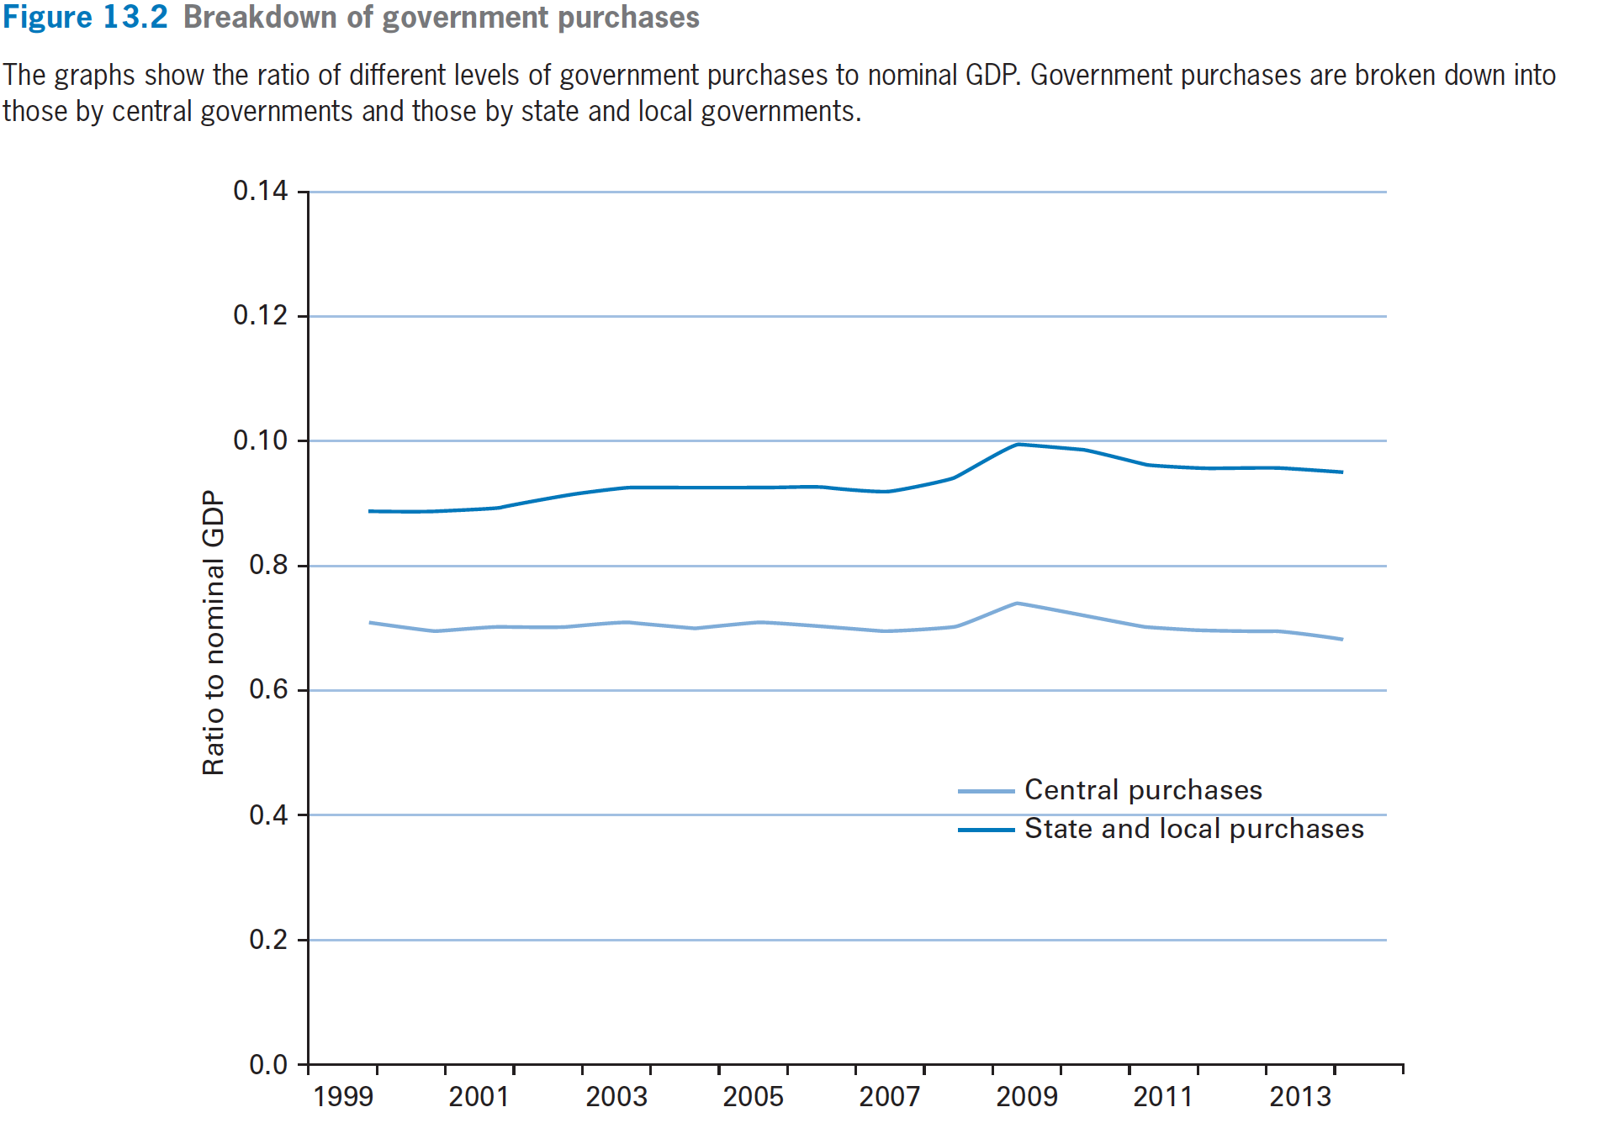
Data on Government Expenditure

Slide 6
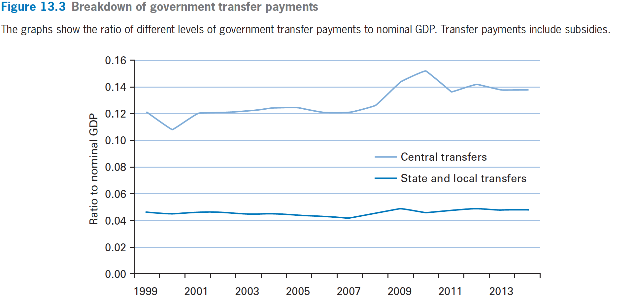
Data on Government Expenditure

Slide 7
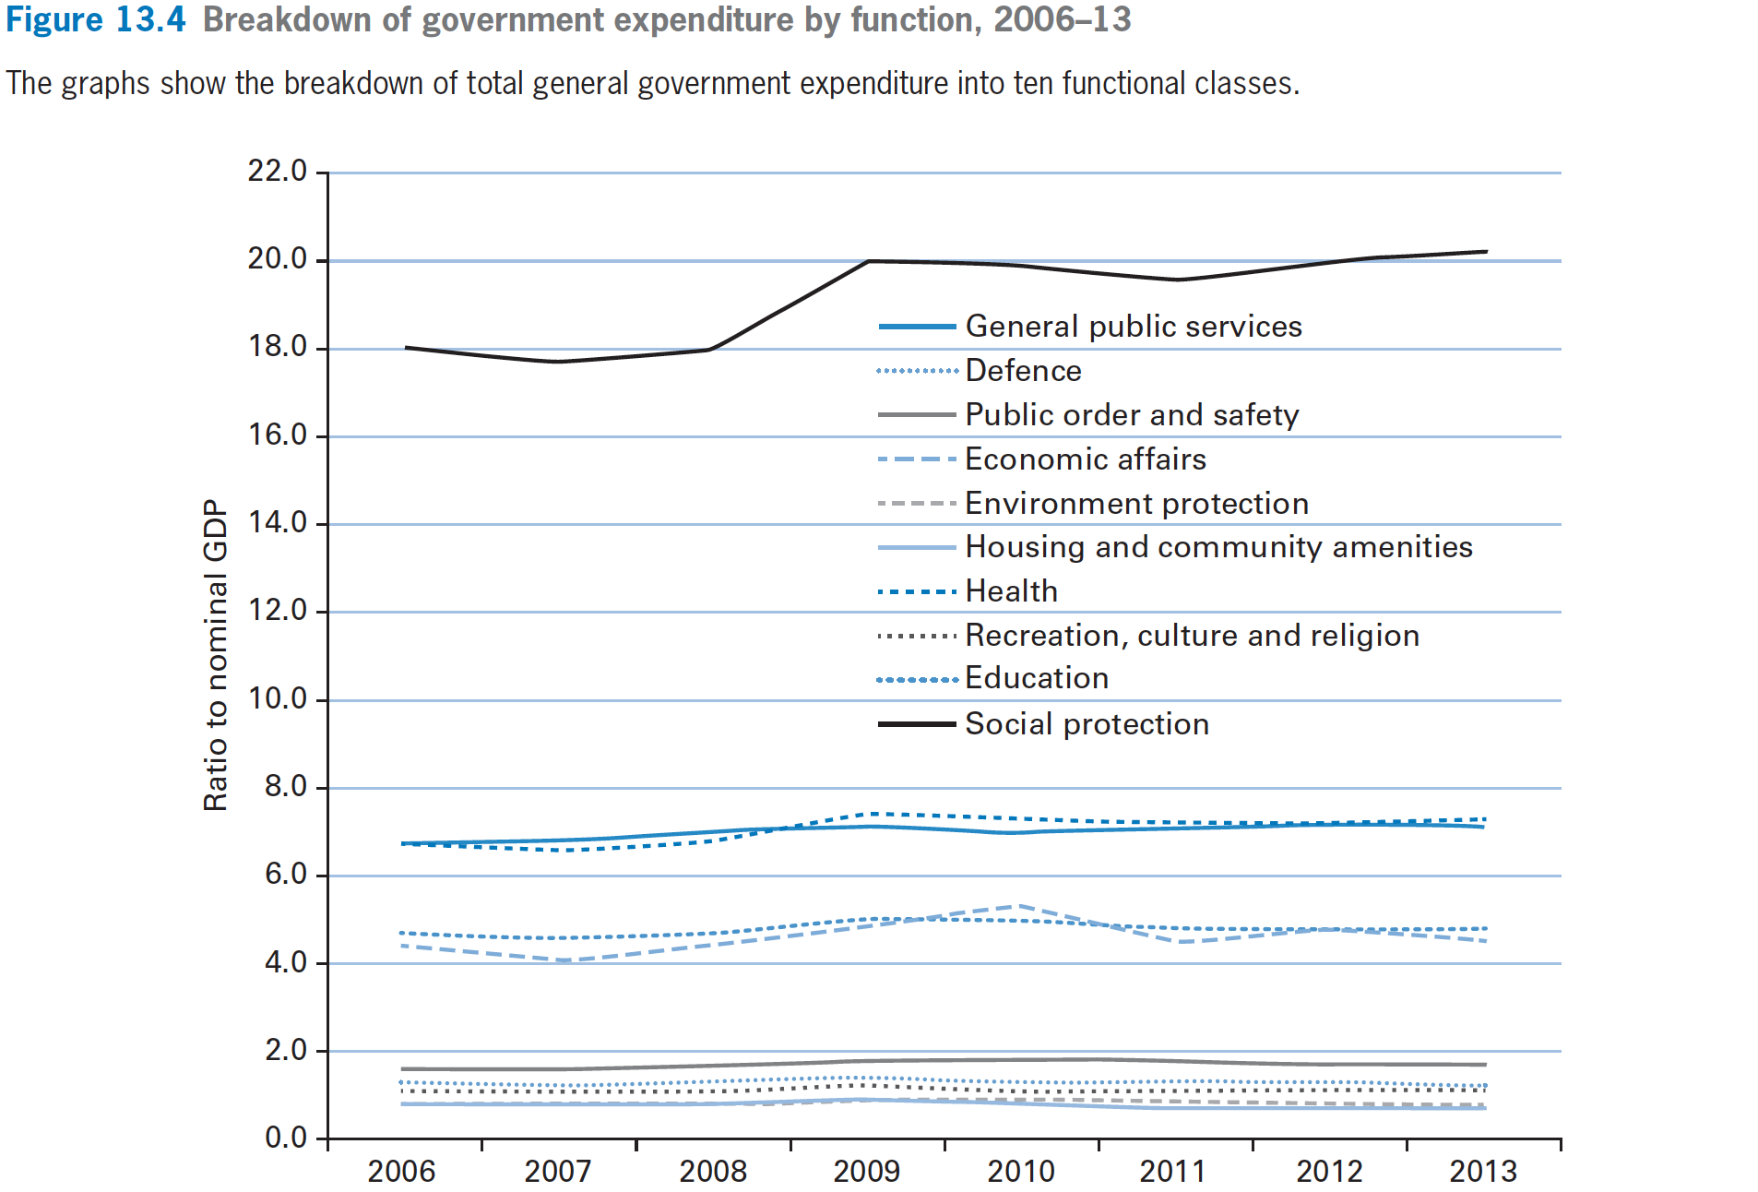
Data on Government Expenditure

Slide 8
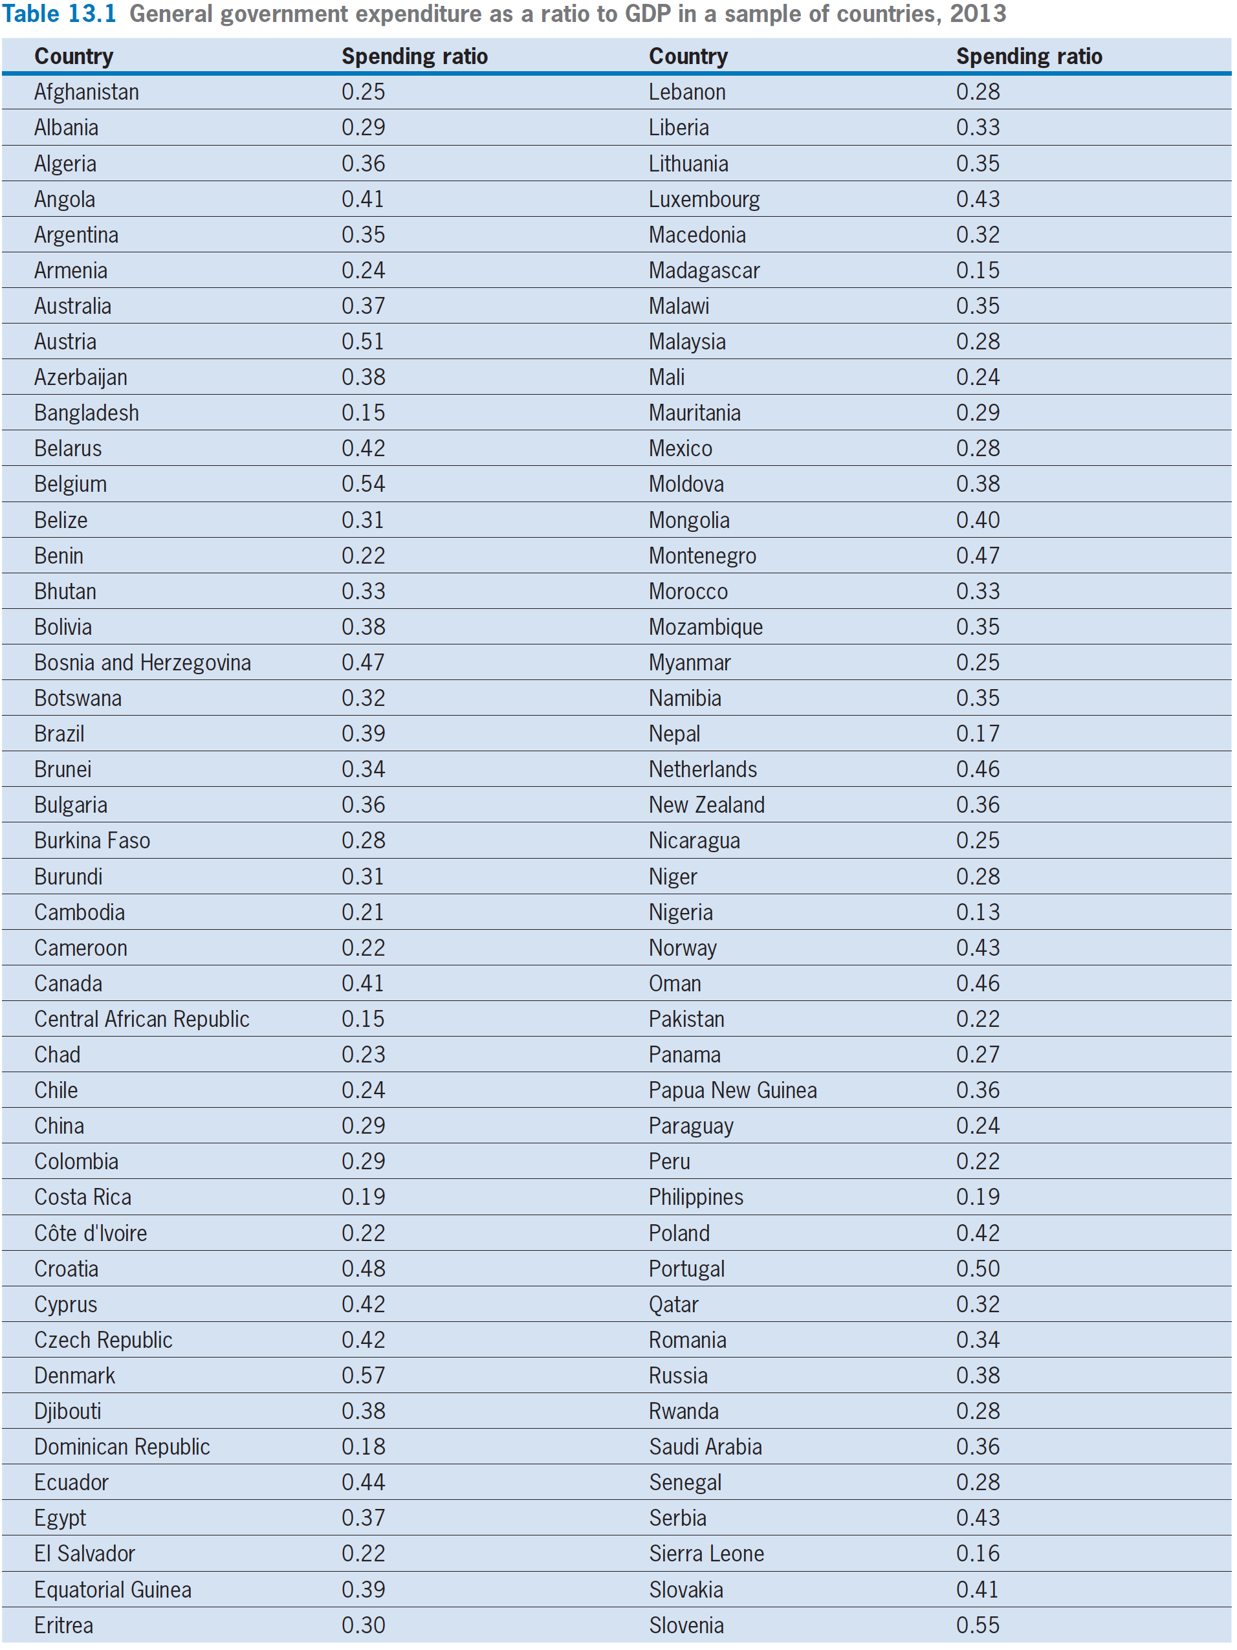

Slide 9
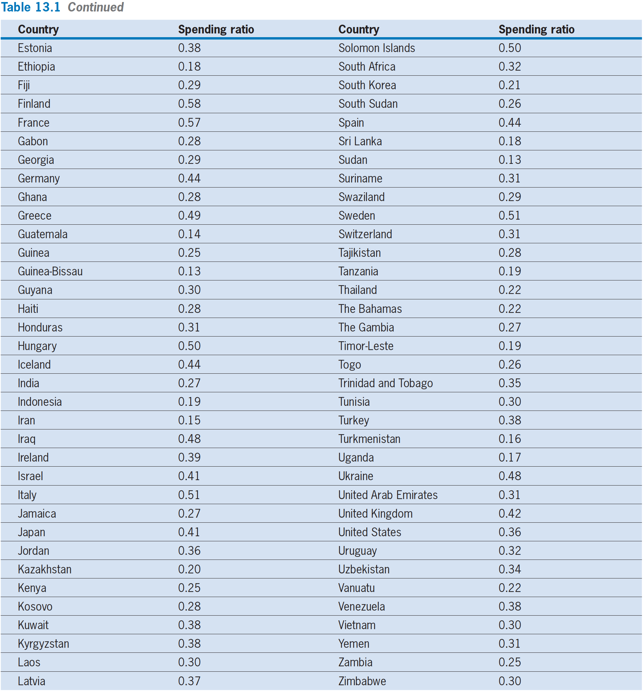

Slide 12
The Government’s Budget Constraint

Slide 13
The Government’s Budget Constraint
G_{t} represent government purchases in real terms for year t.
V_{t} represent the government’s real expenditure on transfers.
No government bonds at this time, so no interest payment right now
The real value of government revenue from printing money in year t is (M_{t} −M_{t−1})/P_{t}
T_{t} be the total real taxes collected by the government in year t.

Slide 14
The Government’s Budget Constraint
Government budget constraint:
  total uses of funds = total sources of funds
  G_{t} + V_{t} = T_{t} + (M_{t}− M_{t−1})/ P_{t}
  real purchases+ real transfers
  = real taxes+ real revenue from money creation

Slide 15
The Government’s Budget Constraint
Government budget constraint
  G_{t} + V_{t} = T_{t}
  real purchases+ real transfers= real taxes
    real revenue from money creation is normally a minor part of overall government revenue.

Slide 16
The Government’s Budget Constraint
Public production: assume that government subcontracts all of its production to the private sector. So public investment, publicly owned capital, and government employment are zero.
Public service: assume public service has no effect on private production efficiency.
Right now, government functions include: G, V, T.

Slide 17
The Household’s Budget Constraint

Slide 18
The Household’s Budget Constraint
Household budget constraint with zero inflation
  C + (1/P)·∆B+∆K = (w/P)·L^{s}+ i·( B/P+K)
With nonzero inflation
  C_{t} + (1/P)·∆B_{t}+∆K_{t} = (w/P)_{t}·L^{s}_{t} + r_{t−1}·(B_{t−1}/P + K_{t−1})
With nonzero inflation and government purchase
  C_{t} + (1/P)·∆B_{t}+∆K_{t} = (w/P)_{t}·L^{s}_{t} + r_{t−1}·(B_{t−1}/P + K_{t−1}) +V_{t} − T_{t}

Slide 19
The Household’s Budget Constraint
Multiyear household budget constraint with government purchase:
C₁ + C₂/(1+r₁) + ··· = (1+r₀)·( B₀/P+K₀)
+(w/P)₁·L^{s}₁ +(w/P)₂ · L^{s}₂ /(1+r₁) + ···
+( V₁ − T₁) + ( V₂ − T₂)/( 1 + r₁)
+( V₃ − T₃)/[(1+ r₁) ( 1 + r₂) ] + ···

Slide 20
Permanent Changes in Government Purchases

Slide 21
Permanent Changes in Government Purchases
Theory
  How the increase in government purchases affects household consumption C?
    G+ V = T , or , V − T = −G
    G rises by one unit each year, V − T falls by one unit each year; that is, household’s disposable real income falls by one unit each year.

Slide 22
Permanent Changes in Government Purchases
  Since the typical household has one less unit of real disposable income each year, we predict that the decrease in C each year will be roughly by one unit.

Slide 23
Permanent Changes in Government Purchases
Theory
  How the increase in government purchases affects the demand and supply of capital services, labor, real rate?
    An increase in government purchases, G, does not shift the curves for the demand or the supply curves of capital services.
    The market-clearing real rental price, (R/P)∗, and quantity of capital services, (κK)∗, do not change.

Slide 24
Permanent Changes in Government Purchases
Theory
  r = (R/P) · κ − δ(κ)
    A permanent increase in government purchases does not affect the real interest rate.

Slide 25
Permanent Changes in Government Purchases
Theory
    G, does not shift labor supply, L^{s}, which is fixed at L, and does not shift the labor demand curve, L^{d}.
    The market clearing real wage rate, (w/P)∗, does not change, so as the labor input.
    We conclude that a permanent increase in government purchases does not affect the real wage rate and labor input.

Slide 26
Permanent Changes in Government Purchases
Theory
  We also assumed the technology level, A, is fixed.
  Therefore, real GDP, Y is unchanged.
    Important conclusion: a permanent increase in government purchases does not affect real GDP.

Slide 27
Permanent Changes in Government Purchases
Theory
  From our analysis of income effects that a permanent rise in government purchases, G, by one unit reduces C in each year by roughly one unit.

Slide 28
Permanent Changes in Government Purchases
Theory
  The intertemporal-substitution effect depends on the real interest rate, r.
  Since r does not change, the intertemporal-substitution effect does not operate.
  Another substitution effect involves consumption and leisure, but we have assumed the quantity of labor and, hence, the quantity of leisure, is fixed. In any event, this substitution effect depends on the real wage rate, w/P, which does not change.

Slide 29
Permanent Changes in Government Purchases
Theory
  Y= C+ I + G
    the changes in C and G fully offset each other and, thereby, allow I to remain unchanged.

Slide 30
Permanent Changes in Government Purchases
Theory
  In summary, we predict that a permanent increase in government purchases, G, by one unit
    Reduces consumption, C, roughly one to one.
    The variables that do not change include: real GDP, Y; gross investment, I; the quantity of capital services, κK; the real rental price, R/P; the real interest rate, r; the real wage rate, w/P; and the labor input, L.

Slide 31
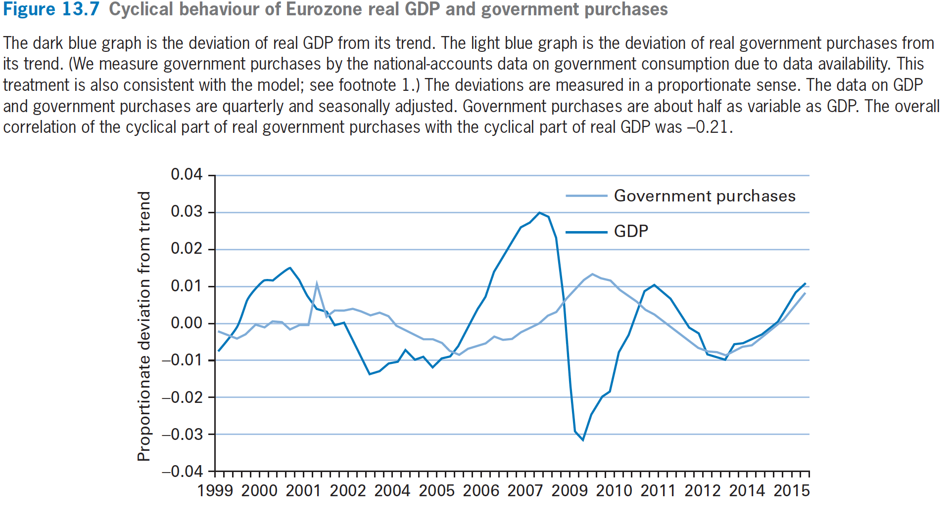
Permanent Changes in Government Purchases

Slide 32
Temporary Changes in Government Purchases

Slide 33
Temporary Changes in Government Purchases
Theory
  Assume now that year 1’s real government purchases, G₁, rise by one unit, while those for other years, G_{t}, do not change.
  That is, everyone expects that G_{t} in future years will return to the original level.

Slide 34
Temporary Changes in Government Purchases
Theory
  V_{t}− T_{t}= −G_{t}
  V_{t}− T_{t} falls by one unit, and households have one unit less of real disposable income. In subsequent years, V_{t} − T_{t} and, hence, real disposable income return to their original levels.

Slide 35
Temporary Changes in Government Purchases
Theory
  Households would spread their reduced disposable income in year 1 over reduced consumption, C_{t}, in all years t.
  Therefore, the effect on year 1’s consumption, C₁, will be relatively small.
  The propensity to consume out of a temporary change in income is greater than zero but much less than one.

Slide 36
Temporary Changes in Government Purchases
Theory
  Y= C+ I + G
  Y, is unchanged; real government purchases, G, are higher in year 1 by one unit; and consumption, C, is lower, but by much less than one unit.
  Consequently, equation Y= C+ I + G implies that gross Investment，I, must fall.

Slide 37
Temporary Changes in Government Purchases
Theory
  Since the decrease in C is relatively small, the decline in I is large. That is, year 1’s extra G comes mainly at the expense of I, rather than C.
  Previously, when the change in G was permanent, we predicted that most or all of the extra G came at the expense of C.

Slide 38
Government Purchases and Real GDP During Wartime: Empirical

Slide 39
Government Purchases and Real GDP During Wartime: Empirical
We test the model by studying the response of the economy to the temporary changes in government purchases that have accompanied US wars.

Slide 40
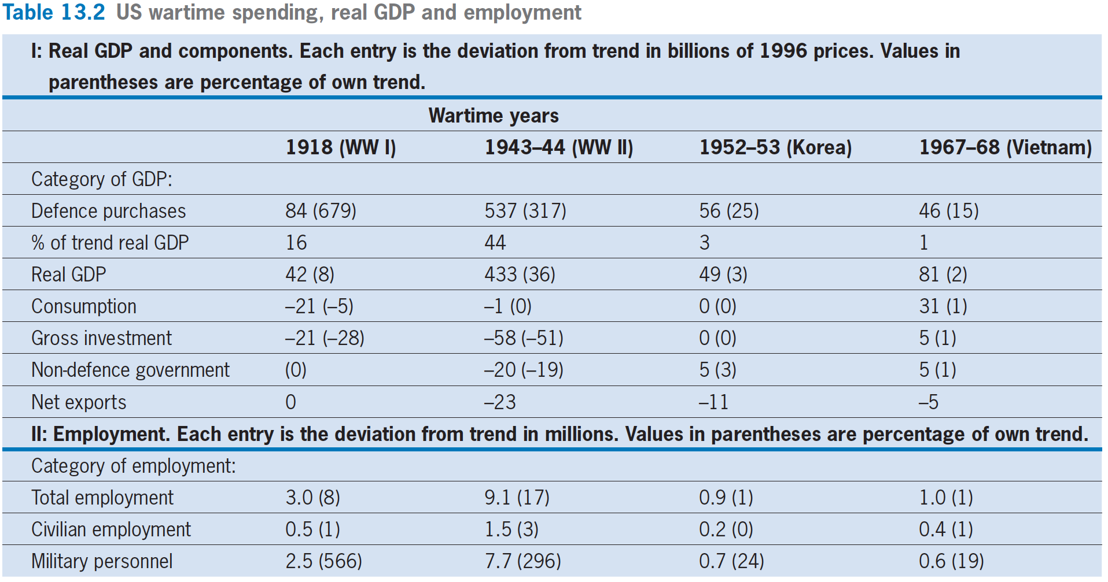
Government Purchases and Real GDP During Wartime: Empirical

Slide 41
Government Purchases and Real GDP During Wartime: Empirical
The data also show that the rises in real GDP are by less than the increases in government purchases. That is, aside from military purchases, the totals of the other components of real GDP （e.g. C, I）are down during wartime.
The model accords with this pattern. However, the components of real GDP other than military purchases (e.g. C, I) do not fall nearly as much as predicted by the model.

Slide 42
Wartime Effects on the Economy

Slide 43
Wartime Effects on the Economy
Employment during wartime
  The basic pattern is that the military took in a significant number of persons
  Total employment expanded a little more.

Slide 44
Wartime Effects on the Economy
  At this point, there is no settled view among economists about the best way to understand labor supply during wartime.
    A large expansion of real government purchases, G, means that households have less real disposable income.
    Casey Mulligan (1998) argues that labor supply, L^{s}, increases during wartime because of patriotism.
    The military draft would affect the labor supply of single women.

Slide 45
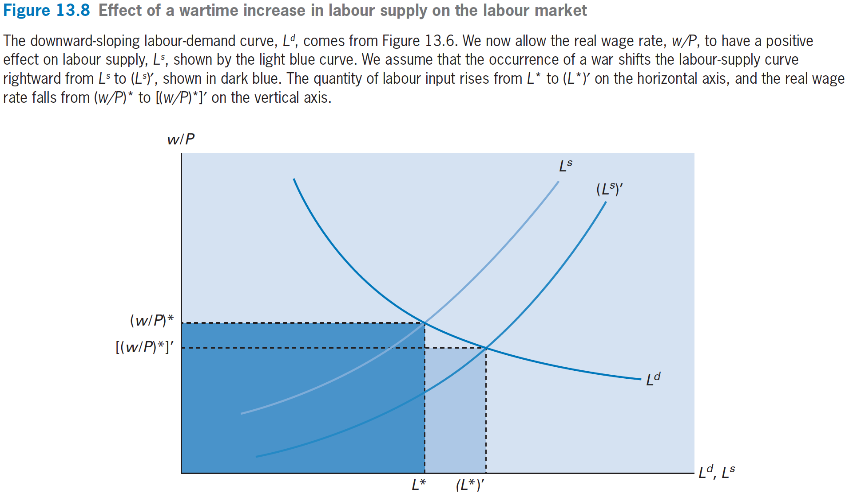
Wartime Effects on the Economy

Slide 46
Wartime Effects on the Economy
Employment Effects on Labor Markets
  Prediction that a war reduces the real wage rate, w/P
  A wartime increase in labor supply, L^{s}, led to an increase in labor input, L.

Slide 47
Wartime Effects on the Economy
Effects of war on the rental market
  a wartime increase in labor supply, L^{s}, led to an increase in labor input, L. This change affects the rental market, because the rise in L tends to increase the MPK (for a given quantity of capital services, κK).
    The demand curve shifts right because the higher quantity of labor, L, raises the MPK for a given quantity of capital

Slide 48
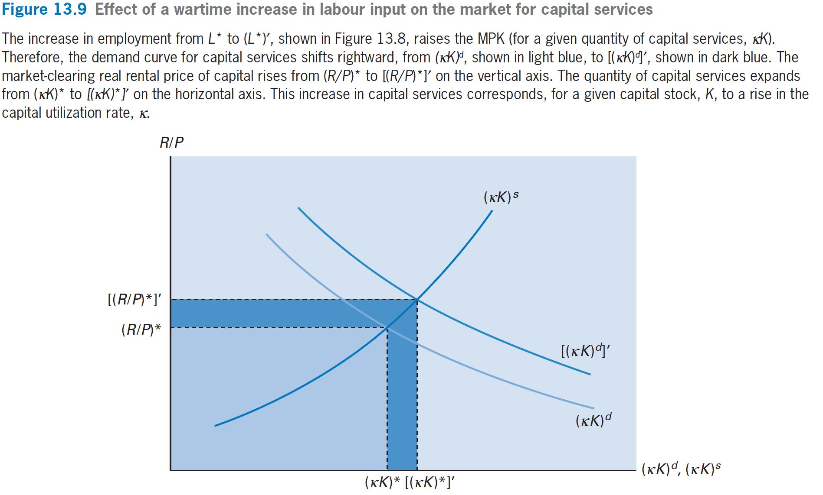
Wartime Effects on the Economy

Slide 49
Wartime Effects on the Economy
For a given capital stock, K, the rise in κK corresponds to an increase in the capital utilization rate, κ.
  r = (R/P) · κ − δ(κ)
    increases in R/P and κ imply that r increases.
    However, the predictions for higher real interest rates during wartime conflict with the US data.

